Slide 1
SUMMER TRAINING PRESENTATION
Name : Monu Gupta
Roll No. : 00311507718
Branch : IT - M

Slide 2
Outlines
I did my Summer Industrial training at Solid State Physics Laboratory, Defence Research and Development Organisation, Timarpur, New Delhi from 3rd June, 2019 to 12th July, 2019.
An amazing experience as i got to see, How exactly the system works for DRDO.
Main objective was to gain the experience of doing work in such a big organisation of India.

Slide 3
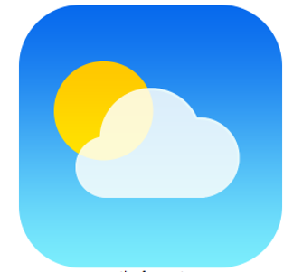
Weather Forecast using Python

Slide 4
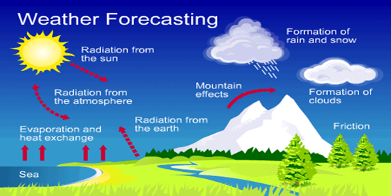
Introduction
Weather forecast is a computer application that gives user information of temperature, weather conditions etc of any place that user searches of.

Slide 5
Working
Python and It’s Libraries
Tkinter
Requests
PIL
Web API
www.openweathermap.org

Slide 6
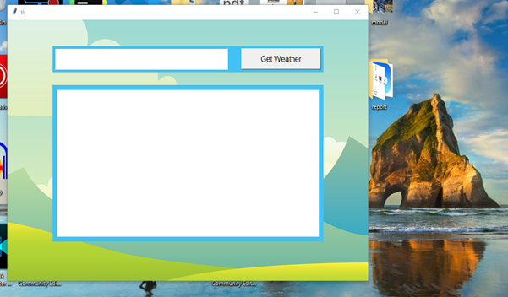
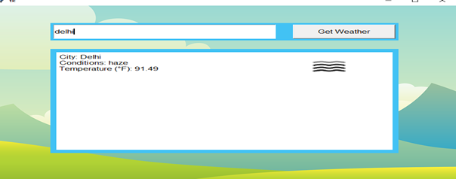
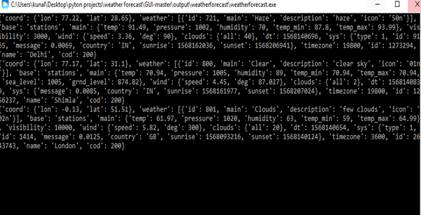

Slide 7
Software and Hardware Dependencies
Software :
Windows Operating System is mandatory for .exe file..
Python should be installed for execution of python file.
Hardware :
Ram – minimum 1 gb.
Processor – minimum core 2 duo.
Space available – 500 mb minimum.

Slide 8
Features of this Application
Atmosphere Pressure
Temperature
Air Density
Humidity
Air Flows Speed and Direction

Slide 9
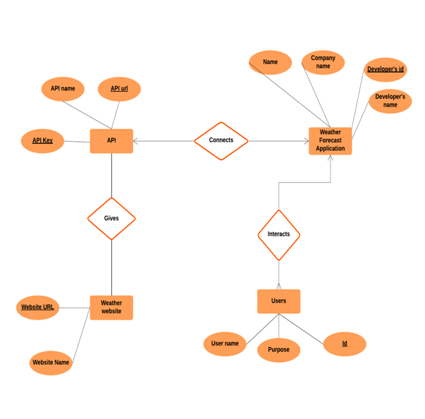
ER Diagram

Slide 10
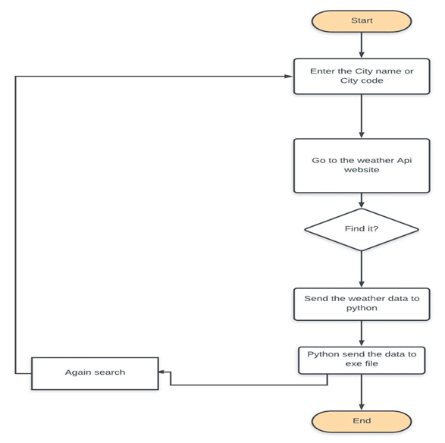
Data Flow Diagram

Slide 11
Future Scope
Portability
Enhancement and Upgradation
Add more features (like pop notification and sharing button, etc).

Slide 12
THANK YOU

